Slide 1

Psychiatric Hospital Accreditation
Survey Preparation Guide

Slide 2
Preparing for Survey
Download Survey Activity Guide
Pre-Survey
Preparing for Survey and Survey Readiness (pages 12-14)
Have Required Documents List Prepared (pages 22-23)
On-Site Survey
Survey Activity List (pages 24-25)
Surveyor Arrival (page 37)
Preliminary Planning Session (page 38)
Opening Conference (page 39)
Organization Orientation (pages 40-41)
Individual Tracer Activity (pages 42-48)
Program Tracer – Suicide Prevention (page 53)
Program Tracer – Lab Integration (page 54)
Program Tracer – Patient Flow (page 55)
Special Issue Resolution (page 60)
Surveyor Planning/Team Meeting (page 61)
Daily Briefing (page 62)
Competence Assessment (page 64)
Facility Orientation – Life Safety Surveyor (page 69)
Life Safety Building Assessment (page 70-71)
  Life Safety/Environment of Care Document List Review Tool (pages 102-116)
Emergency Management (pages 72-73)
System Tracer – Data Management (pages 76-77)
System Tracer – Infection Control (page 78)
System Tracer – Medication Management (page 79)
Leadership Session (pages 89-90)
Medical Staff Credentialing & Privileging (page 93)
Surveyor Report Preparation (page 94)
CEO Exit Briefing (page 95)
Organization Exit Conference (page 96)
Medical Record Summary Review Sheet (pages 117-119)
Medical Staff-Related Standards Compliance Evaluation Guides (pages 120-129)
Kitchen Tracer Guide (pages 130-133)
Imaging Document Review Guide (pages 134-136)

Slide 3
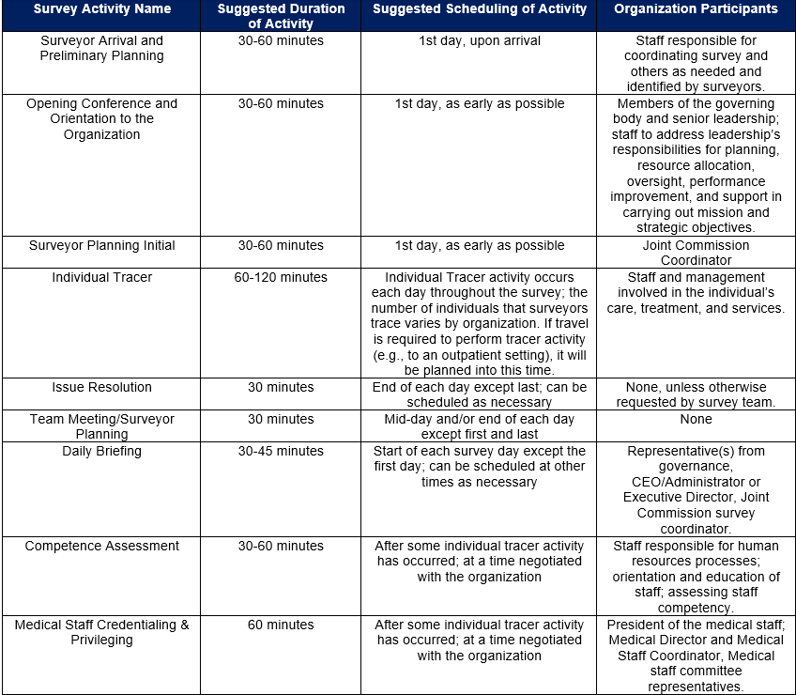
Survey Activities List
Notes:
This slide highlights just some additional details of the Survey activities, designed specifically to follow actual care processes through patient-centered tracer activity. This information is accessible through our Survey Activity Guide which is accessible on our website.

Slide 4
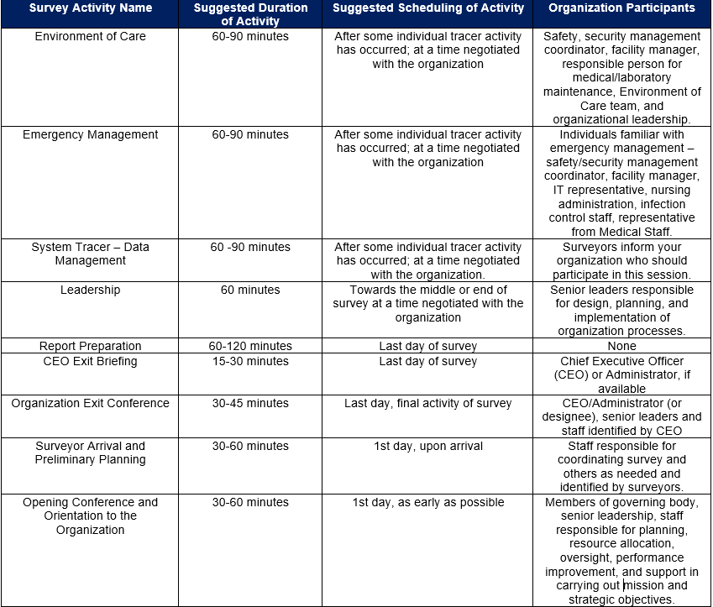
Survey Activities List
Notes:
This slide highlights just some additional details of the Survey activities, designed specifically to follow actual care processes through patient-centered tracer activity. This information is accessible through our Survey Activity Guide which is accessible on our website.

Slide 5
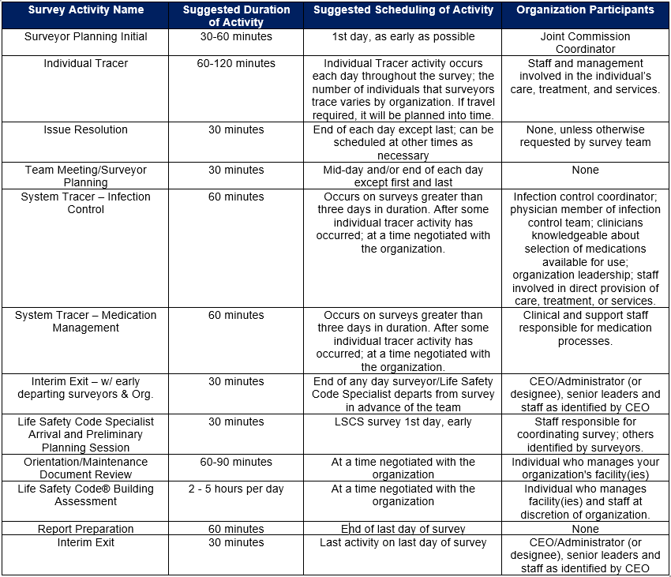
Survey Activities List
Notes:
This slide highlights just some additional details of the Survey activities, designed specifically to follow actual care processes through patient-centered tracer activity. This information is accessible through our Survey Activity Guide which is accessible on our website.

Slide 6
Resources for Psychiatric Hospitals
Suicide Prevention Portal: https://www.jointcommission.org/resources/patient-safety-topics/suicide-prevention/
Physical Environment Portal: https://www.jointcommission.org/resources/patient-safety-topics/the-physical-environment/
Workplace Violence Prevention Portal: https://www.jointcommission.org/resources/patient-safety-topics/workplace-violence-prevention/
Quick Safety Alerts: https://www.jointcommission.org/resources/news-and-multimedia/newsletters/newsletters/quick-safety/
Sentinel Event Alerts: https://www.jointcommission.org/resources/patient-safety-topics/sentinel-event/sentinel-event-alert-newsletters/
Notes:
Suicide Prevention portal contains:
Frequently Asked Questions
Resource Compendiums
Standards Compliance Strategies
Resources, tools and recommendations for organizations to use

Slide 7
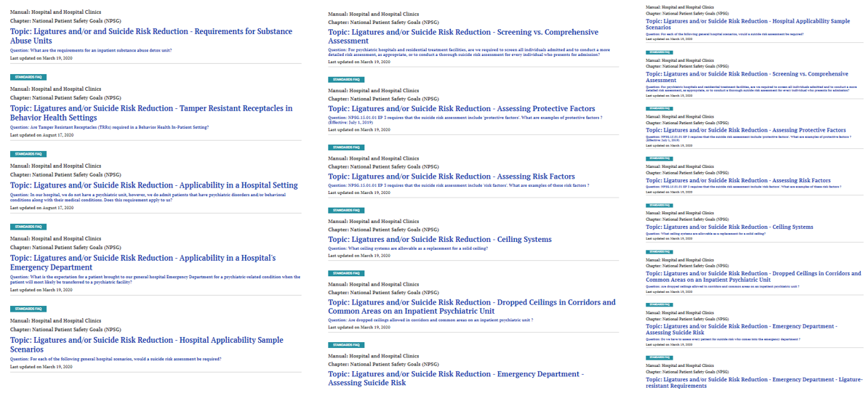
  Resources to Meet Standards Compliance
Standards FAQ’s published by chapter; keyword search (40 FAQ’s on suicide prevention)
https://www.jointcommission.org/standards/standard -faqs/#f:_FacetManual=[Hospital%20and%20Hospital%20Clinics]
Notes:
The Joint Commission also has many resources that can help organizations better understand the intent of a particular standard as well as strategies to comply with them.
Some of these include published FAQ’s on our website that are searchable by name, keyword, or topic
We have 350 published FAQs on the website specific to the hospital accreditation manual
We have 40 published FAQs to address suicide risk reduction
These suicide risk reduction FAQs address standards applicability by setting/unit in the organization, sample scenarios, assessing risk factors, screening assessments, ligature risks, patient monitoring, and general suicide risk reduction questions.
The graphic on the screen displays just a few of these FAQ topics.
When new or revised standards are developed, we also provide reports that provide additional rationale, intent, and requirements of a standard. As well as providing a framework to help organizations understand how they may comply with these standards

Slide 8
Frequently Cited Standards in Psychiatric Hospitals
Notes:
Now that we have highlighted some resources to assist in advancing patient safety and quality, I would like to bring in my colleague Gayle to provide a better understanding of how psychiatric hospitals can proactively implement some compliance strategies to some of the most common challenges that psychiatric hospitals are faced with today.

Slide 9
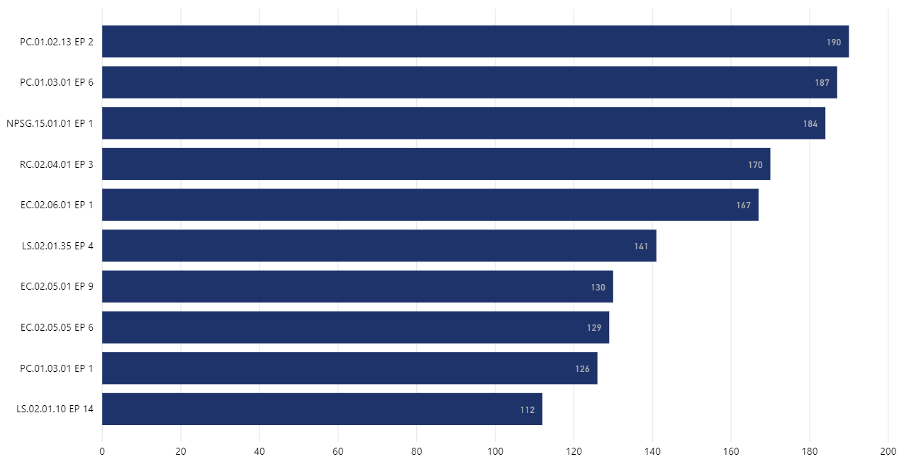
Top 10 Frequently Cited Standards (2019-2020 Survey Events)
PC.01.02.13 EP 2
Psychiatric Evaluation
PC.01.03.01 EP 6
Treatment Plans
NPSG.15.01.01 EP 1
Suicide Risk Assessment
RC.02.04.01 EP 3
Discharge Summary
EC.02.06.01 EP 1
Safe Environment
LS.02.01.35 EP 4
Extinguishing Fire
EC.02.05.01 EP 9
Utility System Labeling
EC.02.05.05 EP 6
Utility Systems; Inspect, Test & Maintain
PC.01.03.01 EP 1
Treatment Plans
LS.02.01.10 EP 14
Fire Protection
0
20
40
60
80
100
120
140
160
180
200
Number of Requirements for Improvements (RFIs)
Notes:
PC 01.02.13 EP 2 Psychiatric Evaluation
PC 01.03.01.EP 6 Treatment Plans
RC02.04.01 EP3 Discharge Summary
EC02.05.01 EP9 Utility System labeling
PC.01.03.01.EP1Treatment Plans
LS.02.01.10 EP 14 Fire Protection

Slide 10
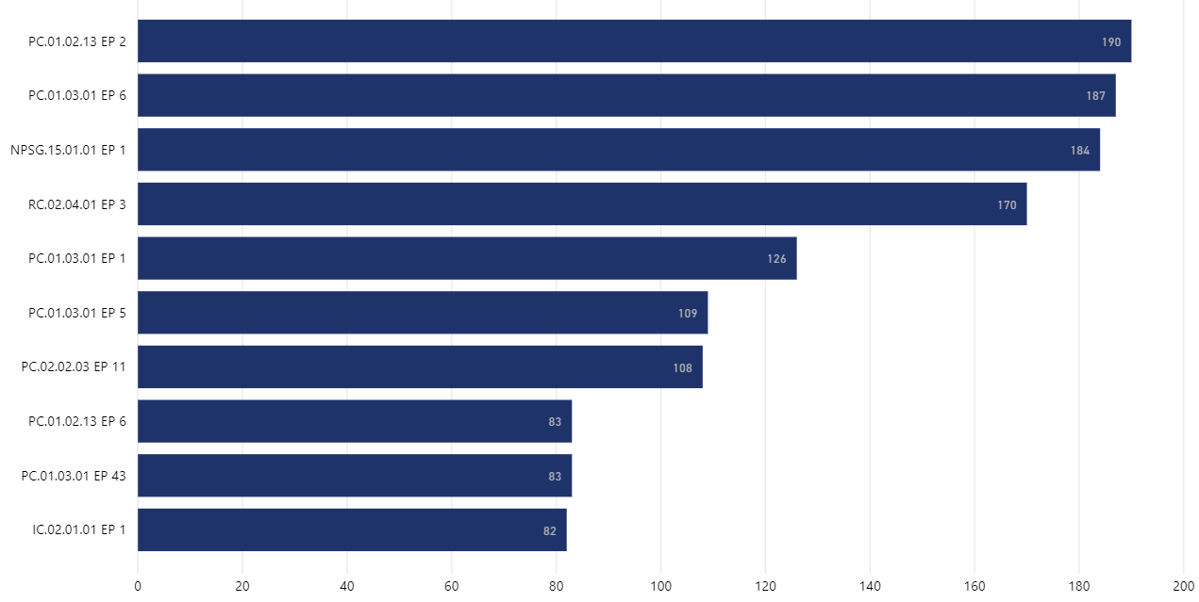
Top 10 Clinical Findings (2019-2020 Survey Events)
PC.01.02.13 EP 2
Psychiatric Evaluation
PC.01.03.01 EP 6
Treatment Plans
NPSG.15.01.01 EP 1
Suicide Risk Assessment
RC.02.04.01 EP 3
Discharge Summary
PC.01.03.01 EP 1
Treatment Plans
PC.01.03.01 EP 5
Treatment Plans
PC.02.02.03 EP 11
Food/Nutrition Storage
PC.01.02.13 EP 6
Neurological Exam
PC.01.03.01 EP 43
Treatment Activities
IC.02.01.01 EP 1
Infection Control
0
40
60
0
20
40
60
80
100
120
140
160
180
200
20
Number of Requirements for Improvements (RFIs)
Notes:
PC 01.02.13 EP 2 Psychiatric Evaluation
PC 01.03.01.EP 6 Treatment Plans he written plan of care includes the following:
- A substantiated diagnosis , Documentation to justify the diagnosis and the treatment and rehabilitation activities carried out
- Documentation that demonstrates all active therapeutic efforts are included
- The specific treatment modalities used to treat the patient
RC02.04.01 EP3 Discharge Summary
PC01.03.01 EP1 Treatment Plans – The hospital plans the patient’s care, treatment, and services based on needs identified by the patient’s assessment, reassessment, and results of diagnostic testing. GAYLE, DOES EP1 DIFFER FROM EP’s 5 and 6?, I ADDED THE VERBIAGE
PC 01.03.01.EP 5 Treatment Plans The written plan of care is based on the patient’s goals and the time frames, settings, and services required to meet those goals.
PC.01.02.13 EP 6 Neurological Exam
PC.01.03.01EP 43 Treatment Activities (please add this) Standard is still there. I was wrong
Documentation to justify the diagnosis and the treatment and rehabilitation activities carried out
- Documentation that demonstrates all active therapeutic efforts are included
- The specific treatment modalities used to treat the patient

Slide 11
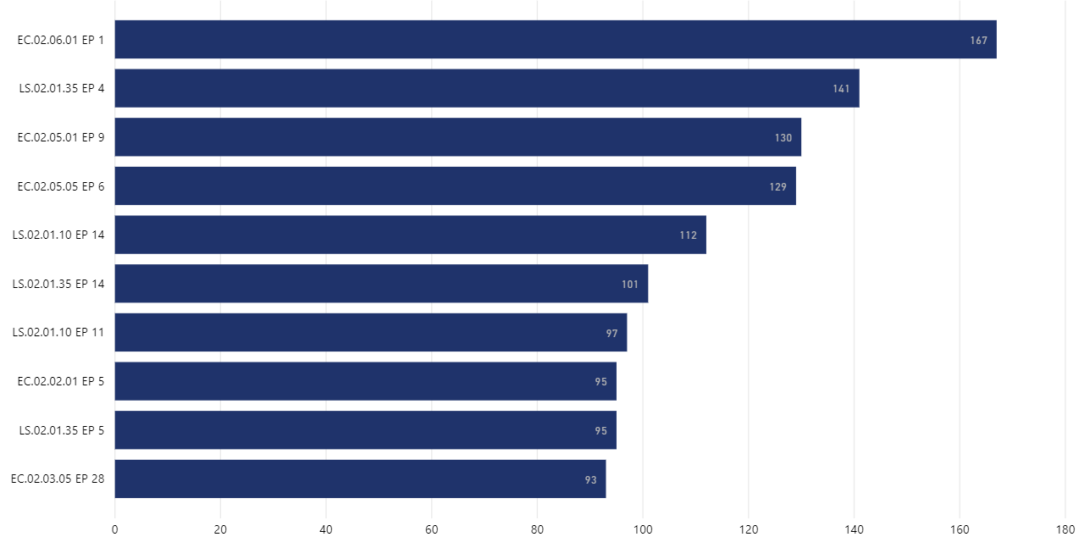
Top 10 Environment of Care/Life Safety Code Findings
(2019-2020 Survey Events)
EC.02.06.01 EP 1
Safe Environment
LS.02.01.35 EP 4
Sprinkler System as Support
EC.02.05.01 EP 9
Utility System Labeling
EC.02.05.05 EP 6
Utility Systems; Inspect, Test & Maintain
LS.02.01.10 EP 14
Fire Protection
LS.02.01.35 EP 14
Extinguishing Fire
LS.02.01.10 EP 11
Fire Doors
EC.02.02.01 EP 5
Hazardous Waste
LS.02.01.35 EP 5
Sprinklers
EC.02.03.05 EP 28
20
40
140
180
0
Documentation of Alarm Testing
60
80
100
120
160
0
Number of Requirements for Improvements (RFIs)
20
40
60
80
100
120
140
160
180
Number of Requirements for Improvements (RFIs)
Notes:
EC.02.05.01 EP 9 Utility Systems Labeling
LS.02.01.10 EP14 Fire Protection
LS.02.01.35 EP 4 Piping for approved automatic sprinkler systems is not used to support any other item
LS .02.01.35.EP 14 Extinguishing Fires – GAYLE, DOES EP4 DIFFER FROM EP14? Yes, The hospital provides and maintains systems for extinguishing fires.ex: blocked fire extinguisher, unable to find the key to unlock the cabinet which contained the fire extinguisher
LS.02.01.10 EP11 Fire Doors
EC.02.02.01 EP5 Hazardous Waste
LS.02.01.35 EP5 Sprinklers
EC.02.03.05 EP28 Documentation of alarm testing

Slide 12
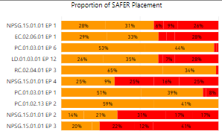
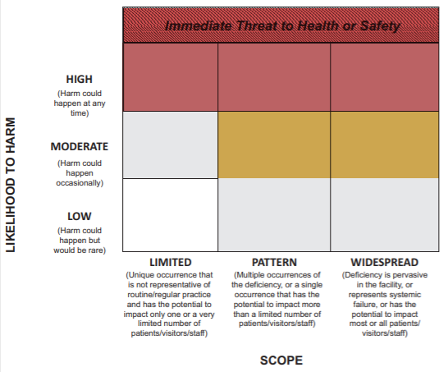
Top 10 Highest Risk Findings (SAFER Moderate / Pattern or Greater)
Safe Environment
Psychiatric Evaluation
Treatment Plans
Suicide Risk Assessment
Discharge Summary
Safe Environment
Extinguishing Fire
Utility System Labeling
Utility Systems; Inspect, Test & Maintain
Treatment Plans
Fire Protection
Notes:
NPSG.15.01.01, EP 1: Suicide Risk Assessment
EC.02.06.01, EP 1: Safe Environment
PC.01.03.01, EP 6: Treatment Plans
LD.01.03.01, EP 12:
RC.02.04.01, EP 3: Discharge Summary
NPSG.15.01.01, EP 4: Document patients’ overall level of risk for suicide and the plan to mitigate the risk for suicide
PC.01.03.01, EP 1:
PC.01.02.13, EP 2:
NPSG.15.01.01, EP 2: Screen all patients for suicidal ideation who are being evaluated or treated for behavioral health conditions as their primary reason for care using a validated screening tool
NPSG.15.01.01, EP 3: Use evidence-based process to conduct suicide assessment of patients who have screened positive for suicidal ideation

Slide 13
Compliance Strategies for Frequently Cited Standards

Slide 14
Psychiatric Evaluation (PC.01.02.13, EP 2)
Deficiency Examples
No documented estimate of intellectual functioning, memory functioning, and orientation with documentation of supporting information in admission assessment
  Mental Status Exam as part of the Admission Psychiatric Evaluation did not document the patient’s behaviors used to conclude judgement and insight
  Patient strengths and weaknesses in the psychiatric assessment were described in overly generalized terms that were not sufficiently descriptive for treatment plan use
  No supporting evidence for the documented degree of cognitive impairment

Slide 15
Psychiatric Evaluation (PC.01.02.13, EP 2)
Compliance Strategies
Document reason for admission as stated by patient and/or family
Do not be vague! Record “who” “what” “where” “when” “why”
Psychiatric Evaluation
  Include mental status exam that describes appearance and behavior, emotional response, verbalization, thought content, and cognition
  Document onset of illness & reason for hospitalization
  Describe attitudes and behaviors
  Include intellectual functioning, memory functioning and orientation. Include supporting evidence as to how this was determined
  Describe patient’s assets

Slide 16
Treatment Plans (PC.01.03.01, EP 6)
Deficiency Examples
The treatment plan did not include interventions for active medical problems
  The patient plan of care did not include the specific, individualized treatment modalities.
  Treatment plan did not include a substantiated diagnosis

Slide 17
Treatment Plan (PC.01.03.01, EP 6)
Compliance Strategies
The Treatment Plan should be the blueprint for all treatment delivered to patient
Substantiated Diagnosis documented in treatment plan
  Serves as basis for treatment interventions
  Developed by synthesizing data from various disciplines
  Rule-out diagnosis is NOT substantiated diagnosis
Specific Treatment Modalities documented in treatment plan
  Simply “stating” modality approach (i.e. “set limits” or “encourage socialization”) is NOT acceptable
  Simply “naming” modalities (i.e. “individual therapy” “group therapy” “medication education”) is NOT acceptable
  Treatment methods and interventions from all disciplines need to be included in treatment plan
  Interventions must be specifically described to assure consistency
  Include specific focus of treatment for each patient for group activity interventions

Slide 18
Suicide Risk Assessment (NPSG.15.01.01, EP1)
Deficiency Examples
No comprehensive suicide risk assessment (SRA) Still highest score on SAFER Matrix (high pattern and high and widespread)
  Incomplete SRA
  SRA inaccurate/inconsistent with clinical information in medical record
  SRA not completed per policy
  No synthesis of individual factors on SRA to determine level of risk and interventions based on that level of risk

Slide 19
Suicide Risk Assessment (NPSG.15.01.01, EP1)
Compliance Strategies
Policy creation and/or revision:
  Suicide risk assessment (SRA) tool
  How often?
  By whom?
  Interventions based upon level of risk
  Define monitoring procedures
Staff Training
  Demonstrated competency assessment for use of SRA tool
  Knowledge of policy/procedures
Leadership Oversight
  Ensure policy/procedure adherence
    Rounding
    Audits of Medical Records

Slide 20
Discharge Summary (RC.02.04.01, EP3)
Deficiency Examples
The discharge summary did not include a summary of the circumstances and rationale for admission
  Patient’s condition at time of discharge was not included in the discharge summary
  The discharge summary did not recap the patient’s hospitalization to include the evaluation of treatment plan goals.

Slide 21
RC.02.04.01 EP3
Discharge Summary (RC.02.04.01, EP3)
Compliance Strategies
Discharge Summary must include:
  Extent to which treatment plan goals were met
  Summary of patient’s hospitalization
    Reason for admission
    Treatment provided
    Baseline of psychiatric, physical, and social functioning at time of discharge
    Response to treatment
    Follow-up services (specific appointments & provider names if applicable)
    Psychiatric, medical/physical treatment and medication regimen
  Summary of psychiatric, medical, and functional condition at time of discharge
Use treatment plan as a guide

Slide 22
Safe Environment (EC.02.06.01, EP 1)
Deficiency Examples
Ligature Risk on Inpatient Units (still highest on SAFER Matrix)
    Doors and door hardware
    Drop Ceilings
    Beds with ligature risks
    Light Fixtures
    HVAC Vents
    Non-Tamper Proof Screws
    Sprinkler Heads
    Bathroom Fixtures (plumbing, toilet paper dispensers, paper towel dispensers, etc.)
    Grab Rails
    Window Treatments

Slide 23
Safe Environment (EC.02.06.01, EP 1)
Compliance Strategies
Consider the following for scoring CLD:
  Not all ligature risks were identified
  Plan of correction not developed and/or does not have an established timeline to remove ligature risks
  Lack of development and/or compliance with clinical mitigation to reduce the risk
    Policy/Procedure for suicide risk assessments
    Identify high risk patients
    Implement 1:1 monitoring of high-risk patients

Slide 24
Extinguishing Fire (LS.02.01.35, EP 4)
Deficiency Examples
Cabling wrapped around the sprinkler pipe
  Conduit, tubing, wiring supported by the sprinkler system

Slide 25
Extinguishing Fire (LS.02.01.35, EP 4)
Compliance Strategy
Ensure that the sprinkler piping cannot be used to support anything. This includes items that are touching the piping.

Slide 26
Utility System Labeling (EC.02.05.01, EP 9)
Deficiency Examples
The water source valve to the building was not labeled
  The electrical panel did not have an accurate legend depicting what the circuit breakers serve
  The fire alarm circuit disconnect/electrical breaker was not identified

Slide 27
Utility System Labeling (EC.02.05.01, EP 9)
Compliance Strategies
At a minimum, the main valves/controls for the utility systems need to be labeled
Electrical panel must have legend and be accurately identified
If the circuit breakers are installed they must be identified on the legend whether spares or in service.

